Slide 1
Advanced C++
Chapter 10 (Objects a Deeper Look Part II)
Fall 2011
Kristina Shroyer

Slide 2
Chapter 10 Objectives
Ch 10 Classes: A Deeper Look Part 2
We'll divide this lecture into two parts:
Part 1
  const
  the this pointer
Part 2
  Composition
  friend functions and friend classes
  REVIEW intializers new and delete
    This is actually a repeat, we already went over this in Chapter 8
  static class members

Slide 3
Using const
It's important in program design to never open things to possible modification that shouldn't be
  Your book calls this the principle of least privilege
You may want to make some object instances of your class modifiable and others not modifiable
  By using const you can make it so any attempt to modify such an object would result in a compilation error
Example:
  const Time noon(12,0,0);
  Any attempt to modify the noon object would cause a compile time error rather than an execution time error
Last week we were using const to make function parameters non modifiable

Slide 4
Using const
const member functions (this is talking about making ENTIRE MEMBER FUNCTIONS const)
C++ disallows member function calls for const objects unless the member functions are also declared const
  This is true even for get functions that don't modify the object (unless you declare them const which you should if they don't modify the object and shouldn’t' modify it – see next bullet)
  This should be OK though because any object you declare const you would never want to call functions that modify the object
    So you can make the member functions that don't modify the const object const
In addition, often it is acceptable to let the client inspect (but not modify) private member variables through certain member functions
  These functions are often called observer functions
  Because these functions are not intended to modify the private data they inspect they are declared with the keyword const following the parameter list
  So in addition to allowing const objects to call get functions and other functions that don't modify objects (by making them const) it is also desirable to declare const member functions to prevent the functions themselves from modifying private data
Basically what this means is design wise, all member functions that are intended only to let the client inspect the private member data (but not modify it) should be declared const member functions
  This way const objects (instances) can use these functions and these functions cannot change private member data

Slide 5
const Member Functions
To specify a const member function
  A const member function must be declared const in both its prototype (in the declaration/specification file) and in its function definition (in the implementation file)
    To declare a function prototype const insert const after the function's parameter list
    To declare a function definition const insert const after the function's parameter list, before the left brace that starts the function body
Compilation Errors
  Invoking a non-const member function from a const object
  Defining a function as const that modifies a private data member
  Defining a const member function that calls a non-const member function of the class on the same instance of the class

Slide 6
const Member Functions
Tip:
  A const member function can be overloaded with a non-const version of the member function
    The compiler chooses which overloaded member function to call based on the object which invokes the function
      If the object is const the const version of the member function is invoked
      If the object is non-const, the non-const version of the member function is invoked
You are not allowed to use a const declaration for constructors and destructors
  Both constructors and destructors MUST be able to modify objects
A good design practice is to always declare member functions that do not and should not be able to modify the private members of the class as const

Slide 7
const Member Functions
Example 1: The Time Class Modified with const where needed
  What if I forgot to call one of the print functions const?
    Where would the program fail?
  What if I tried to call one of the set functions with the noon object?
    Uncomment code and see
Note:
  Even though our constructor must be a non-const member function it can still be used to initialize a const object
    The "const" status of an object is enforced from the time it is initialized (so once the constructor is complete) until the time the destructor is called
  Even if an member function does not modify an objects private member data if you forget to label it as const, a const object will not be able to use it

Slide 8
Initializing const data members with member initializers
All data members of a class instance can be initialized in the class implementation using member initializer syntax
Types of data members that must be initialized using member initializer syntax
  const data members (members of the class whose value should not change) MUST be initialized using member initializer syntax (and they must be initialized)
    A const data member is simply one you don't want any functions of the class to be able to modify
  Data members that are references also must be initialized using member initializer syntax and member objects must be as well (you may or may not want these initialized in the constructor
Member initializers
  appear between the end of a constructor's parameter list and the opening curly brace of the constructor's function body
  The member initializer list is separated from the parameter list with a semicolon :
  Each member initializer consists of the data member name followed by parenthesis containing the member's initialization value
  Multiple member initializers are separated by commas
Since a const object cannot be modified by assignment your only choice is to use a member intializer in the constructor to initialize the value for of the const data member of an instantiated object
  The same is true for data members that are references
Let's look at Example 2 which shows how this is done
NOTE: only constructors can have member initializers
Member initializer lists are executed before the
body of the constructor

Slide 9
The this Pointer
Example 6: A simple object oriented program (YES THE EXAMPLES ARE OUT OF ORDER – just pay attention to example numbers)
  #include <iostream>
  using namespace std;
  class Example
  {
  private:
  int x;
  public:
  Example1(int);
  int getValue();
  };
  //implementation section
  Example1::Example1(int a)
  {
  x = a;
  }
  int Example1::getValue(){
  return x;
  }
  int main()
  {
  Example1 obj1(10);
  Example1 obj2(20);
  cout << "obj1 is " << obj1.getValue() << endl;
  cout << "obj2 is " << obj2.getValue() << endl;
  return 0;
  }
The output from this program is:
  obj1 is 10
  obj2 is 20

Slide 10
More Object Oriented Concepts - The this Pointer
Each time an object is created, distinct area of memory is set aside for its member variables
However, there is no replication of memory for member functions
  For each class, only one copy of each member function is retained in memory
  Each object uses same member functions but has memory for their own member variables
Different objects of a class type are called instances of that class and that each instance of a class has its own copy of the data members (member variables) listed in that class
  In the previous example obj1 and obj2 are instances of the Example class each with it’s own data member x.
  obj1’s data member (member variable) x contains the value 10 and obj2’s data member x contains the value 20.

Slide 11
More Object Oriented Concepts - The this Pointer
Now look again at the Example class’s getValue() member function:
    int Example::Example getValue()
    {
    return x;
    }
The function is supposed to return the data member x from some object of the Example class
  If all objects use the same functions, how does the function know which object to use? (there can be several object instances of the same class created)
By default, the compiler provides each member function of every class an implicit parameter that is a pointer to the object of the class it is to operate on.

Slide 12
More Object Oriented Concepts - The this Pointer
Each time an object is created, distinct area of memory is set aside for its data members (member variables)
  By default, the compiler provides each member function of every class an implicit parameter that is a pointer to the object of the class.
      int Example::Example getValue()
      {
      return x;
      }
    So this function actually contains one implicit parameter of type pointer to Example, when the function is called a pointer to the object calling it is passed to it
    This is how the function knows which object to getValue from
      So whatever object calls getValue() implicitly passes a pointer to itself to the function
So the when the following function calls are made:
    obj1.getValue();
    obj2.getValue();
  In the first function call the implicit pointer parameter (the address of obj1) is passed to getValue() ( &obj1 )
  In the second function call the implicit pointer parameter (the address of obj2) is passed to getValue() ( &obj2 )

Slide 13
More Object Oriented Concepts - The this Pointer
Let's say we added the following setValue member function to the Example class
      void Example::Example setValue(int a)
      {
      x = a;
      }
So even though the programmer wrote this function to take a single parameter of type int, it reality it has two parameters:
  a pointer to an object of the class Example
    So whatever object calls getValue() implicitly passes a pointer to itself to the function
  the int specified by the programmer
So the when the following function calls was made:
    obj2.setValue(78);
  There are two parameters passed to setValue, the explicit parameter 78 and the implicit parameter &obj2

Slide 14
More Object Oriented Concepts - The this Pointer
The implicit pointer passed to the compiler by a object's call to a member function can be accessed by code inside that function using the keyword this
For example a member function of the Example class could access the object through which it is called by using the expression:
  *this
  The member function could also access any members of the object using the same pointer
    Best seen in an Example

Slide 15
class Example //(Example 7) (YES THE EXAMPLES ARE OUT OF ORDER! – it is ok we will live)
{
private:
int x;
public:
Example(int);
void setValue(int);
void printAddressAndValue(); //to demonstrate the this pointer
};
/*The Example Constructor initializes x to the value passed into it*/
Example::Example(int a){
x = a;
}
/*The setValue function x to the value passed into it*/
void Example::setValue(int a){
x = a;
}
/*Use the this pointer to print the address of the Example object & value of its member x*/
void Example::printAddressAndValue(){
cout << "The object at address " << this << " has value " << (*this).x << endl;
}
int main()
{
Example obj1(10), obj2(20); //declare two example objects and initialize
//Print the addresses of the two objects using the address & operator
cout << "The address of obj1 is " << &obj1 << " and the address of obj2 is " << &obj2 << endl;
//Now print the addresses and values of the objects from within the member function
obj1.printAddressAndValue();
obj2.printAddressAndValue();
return 0;
}
Notes:
You'll see the address of obj1 and obj2 is the same when the this pointer is used inside the member function called and when used with the & operator in main

Slide 16
Example 7 - The this Pointer
Program Output:
  The address of obj1 is 0x22ff74 and the address of obj2 is 0x22ff70
  The object at address 0x22ff74 has value 10
  The object at address 0x22ff70 has value 20
  Press any key to continue . . .

Slide 17
More Object Oriented Concepts - The this Pointer
When is the this pointer useful?
Consider the member function from our Example class:
  void Example::setValue(int a)
  {
  x = a;
  }
It’s natural to want to set the parameter passed into the function to x like so:
  void Example::setValue(int x)
  {
  x = x; //DOESN’T WORK
  }
The Above code will NOT work! – OUTPUT IS GARBAGE
Why?
  A formal parameter to a member function with the same name as a member of the class will hide the class member making it inaccessible inside the function

Slide 18
More Object Oriented Concepts - The this Pointer
The this pointer can be used to qualify the name of the class member and make it visible again
See Example Program (Example 8)
  void Example::setValue(int x)
  {
  this->x = x; //the -> dereferences the pointer
  }
Remember this->x is equivalent to (*this).x

Slide 19
Constant Member Functions
What if you don’t want a member function in your class to be able to use *this to implicitly change a data member
For example if the example class had a the following getValue function:
    int Example:: getValue()
    {
    return x;
    }
You wouldn’t want the this pointer used in this function because it could be used to modify x in a way you did not intend
    int Example:: getValue()
    {
    (*this).x = 15;
    return x;
    }

Slide 20
Constant Member Functions
Remember, the keyword const serves as an indication to the compiler that the member function should not be allowed to modify its object
  const needs to go in the functions prototype in the class declaration and in the implementation section as well as shown
  class Example
  {
  private:
  int x;
  public:
  Example(int);
  int getValue()const; //getValue() cannot modify x using *this
  }
  //implementation section
  Example(int a){
  x = a;
  }
  int Example::Example getValue() const //getValue() cannot modify x using *this
  {
  return x;
  }
See Example Program (Example 9)
Notes:
Show what would happen if getValue tried to change x

Slide 21
this Pointer - Summary
Member functions know which object’s data members to manipulate
  Every object has access to its own address through a pointer called this (a C++ keyword)
  An object’s this pointer is not part of the object itself
  The this pointer is passed (by the compiler) as an implicit argument to each of the object’s non-static member functions
Objects use the this pointer implicitly or explicitly
  Implicitly when accessing members indirectly
  Explicitly when using keyword this
  Type of the this pointer depends on the type of the object and whether the executing member function is declared const

Slide 22
this Pointer – cascading function calls
Cascaded member-function calls
  Multiple functions are invoked in the same statement
  Enabled by member functions returning the dereferenced this pointer
  Example
    t.setMinute( 30 ).setSecond( 22 );
      Calls t.setMinute( 30 );
      Then calls t.setSecond( 22 );
  A dereferenced object is just an address to where that object's members are in memory, so when we dereference this without using the dot operator to explicitly get the value of a member we just have the address to where that objects members are stored
Best seen in an Example
  Example 10
Why does returning *this as a reference work?
  The dot operator associates from left to right, so the cascading line first evaluates t.setHour(18) then returns a reference to object t as the value of the function call (t)
    so the next call is really t.setMinute(30)

Slide 23
Composition
One of the key concepts of object oriented classes is defining and implementing relationships between different classes
Composition: Object composition occurs when a class contains an object of another class as a member
Imagine an AlarmClock class
  An alarm clock needs to know what time to sound so it would be logical to have an object (instance) of the Time class as a data member of the Alarm clock class
  This relationship is called composition or a has a relationship, a class can have objects of other classes as members
  Composition is a common form of reusability in software programming & design
When an object is created the constructor is automatically called as we know (this includes objects that are members of other objects via composition)
  We know we can pass arguments to constructors
  What we'll see is that we can also pass arguments to an object's constructor for the member objects' constructors
    We'll do this with member initializers

Slide 24
Composition
We'll look at two examples of Composition
  The first one will not pass any arguments to the member objects' constructor
In the first example we have a Date class and an Employee class which has a member that is an object of type Date
This is Example 3 (YES THE EXAMPLES ARE OUT OF ORDER! – it is ok we will live)
  This example illustrates a class named Employee that contains an instance of another class Date
Note the #include headers used in Example #3
  Before an instance can be created in a class definition (just as in a client) the class definition must be included, you have to set up the #includes in a way where they are done at the earliest point needed and aren't done twice, though we have used #ifndef and #endif in case they do get included twice
  Employee.h has to include Date.h
  Employee.cpp only has to include Employee.h
  Date.cpp only has to include Date.h
  The client only has to include Employee.h

Slide 25
Composition – The Has-A Relation
Remember one of the key advantages of object oriented programming is the relationships different classes used in a program application can have with each other
  These relationships make programs easier to design, easier to read, and provide for reusability of code
When one class contains an instance of a second class the first class is said to have a Has-A relation to the second
  In the previous example Employee Has-A Date class member in the form of its dob member
This Has-A relation is important in modeling relationships among classes and objects in the design of an object oriented system
  Large programs are composed of many objects which have relationships to each other (just like objects in the real world)

Slide 26
Composition – The Has-A Relation
EMPLOYEE
firstName : string
lastName: string
hireDate : Date
Member functions go here
UML – Composition
This Example shows how UML can model the relationship between the Employee class and the Date class
  The Employee class has a Date
    It is composed of 1 Date object
    An object can be composed of more than one of an object (maybe an array or linked list or objects)
The member attributes and functions were left out to save space
The 1 to 1 shows how many Date objects one Employee object is be composed of
There are different ways of doing UML but the relationships it depicts are all the same
You don't have to put all these relationships in your UML diagrams (but it's good practice to try) if you don't want to but do understand the basics of this diagram
1
1
DATE
Member attributes go here
Member functions go here

Slide 27
Composition: Initializing Member Objects
Now we're going to see a better way to implement composition
  Now our Employee class is going to be composed of two Date objects (birthDate and hireDate)
    Both Date objects are going to be const since we don't want them to be able to be changed by the Employee class
  The Date objects are going to be initialized using a member initialization list since that is the only way to initialize const member variables and objects
    Also remember that we can use initialization lists to initialize non const member variables and objects as well
Initializing member objects
  Member initializers pass arguments from the object’s constructor to member-object constructors
  Member objects are constructed in the order in which they are declared in the class definition
    Not in the order they are listed in the constructor’s member initializer list
    Before the enclosing class object (host object) is constructed
  If a member initializer is not provided
    The member object’s default constructor will be called implicitly (like we did in Example 3)

Slide 28
Composition: Initializing Member Objects
See Example 4 (YES THE EXAMPLES ARE OUT OF ORDER! – just pay attention to what number example we are using)
Look at the new Employee Constructor
The first two parameters are passed using member initializers – QUESTION: Did they have to be passed using member initializers?
The last two parameters are passed using member initializers to the constructor for the class Date
  You will note that the class Date does NOT have a constructor that receives a parameter of type Date
    What's really happening is the class's default copy constructor is being called (remember this from memberwise assignment in the last chapter), so really the copy constructor is being called and each data member of the constructors argument object is copied into the corresponding member of the object being initialized
So our program creates two Date objects and passes them as arguments to the constructor of the Employee object
  You'll note when the Employee constructor executes the print statement we put in the Date constructor is NOT executed
  This is because the copy constructor rather than the Date constructor is executed
    So a constructor is being called it's just a different one than we are used to
    Remember the copy constructor we are using is the one provided by default by the compiler that does memberwise assignment
    When we discuss operator overloading next week you will see how to create your own copy constructors
Remember the member initializer syntax list is done BEFORE the body of the constructor

Slide 29
Composition: Initializing Member Objects
Example 4 (continued)
Destructors & Constructor calls
  Constructors are called from the inside out (in order of construction)
    Note that special copy constructors are called when each of the Employee's Date member objects are initialized in the Employee constructor's member initializer list – so there are four date objects in our program, the two created in main and the two that are members of the Employee manager instance
  The destructors are called in the reverse order of construction (from the outside in)
    Analyzing the objects constructed in main you can see this is true
      First the Date object invalid is destructed
      Then the Employee object manager is destructed
        Both of employee's Date members that were created with the default copy constructor are then destructed
      Then the Date object hire is destructed
      Then the Date object birth is destructed
  When an object contains other objects they are destroyed from the outside in, we can't see it but when the Employee object Manager is destructed:
    First the Employee object manager is destructed
      Then its Date member objects hireDate and birthDate are destructed (in the order they were in the member initialization list)
Note that member objects do not have to be explicitly initialized with a member initialization list
  If not explicitly initialized the default constructor will be called implicitly
    Then set functions can be used to change the values
    Of course our date objects could no longer be cosnt
    Also as we saw in Example 3, this approach does require more work

Slide 30
Performance Tip 10.2
Initialize member objects explicitly through member initializers.
  This eliminates the overhead of “doubly initializing” member objects—once when the member object’s default constructor is called and again when set functions are called in the constructor body (or later) to initialize the member object.

Slide 31
Software Engineering Observation 10.7
If a class member is an object of another class, making that member object public does not violate the encapsulation and hiding of that member object’s private members.
However, it does violate the encapsulation and hiding of the containing class’s implementation, so member objects of class types should still be private, like all other data members.

Slide 32
friend Functions
A friend function is a function that is not a member of the class but has access to the private members of the class
  friend functions will be declared outside of a class's scope but will have the right to access the non public members of the class
  remember private members are hidden from all parts of a program outside of a class
    Sometimes though you want to make an exception to this and that is what friends are for
    you should NOT do this unless you have a good reason (violates idea of what OOP is about) – we'll learn a good reason in Chapter 11
Class's can have friends that are standalone functions or that are entire classes
  So an entire class can be declared to be a friend of another class
Friend functions can be used to enhance performance
  For now we'll just see mechanically how a friend function works
  In the next Chapter on Operator Overloading you'll see a practical use of friend functions

Slide 33
friend Functions
Friendship is something that is granted not taken
  So for classB to be a friend of classA, classA must explicitly declare that classB is its friend
    friendship is NOT symmetric, meaning just because classB is a friend of classA this does NOT mean classA is also a friend of classB unless classB explicitly defines this to be true
  friendship is also not transitive
    So if classA is a friend of classB and classB is a friend of classC, you cannot infer classA is a friend of classC

Slide 34
friend Functions
How friend functions are implemented
The prototype:
  precede the prototype with the word friend
  Format:
    friend <return type><function name>(<parameter list>)
  Example to declare a standalone friend function:
    friend void setX(Count &c, int val);
    This means this function can access the private members of this class
  Example to declare a class that is a friend of another class:
    friend class ClassTwo;
    If this prototype was in a class named ClassOne, this would declare all member functions in ClassTwo as friends of ClassOne
Prototypes/declarations for friend functions are by convention declared first in the class definition before the word public or private but technically can be declared anywhere in the class definition
It can be argued that friendship corrupts information hiding and weakens the principles behind Object Oriented Design
  This is true if friendship is used in the wrong way and for the wrong purposes
  As we go through more examples in the next weeks you'll see examples of when friendship can be used and why

Slide 35
friend Functions
Example 5 (YES THE EXAMPLES ARE OUT OF ORDER – watch the numbers carefully)
  Right now the point is just to show you technically how friend functions work, the friend function in this example should technically be a member function
  You'll see more practical applications of friends in the next Chapter on operator overloading
  First look at the header file
    Again note the placement of the friend function prototype – it is there by convention
  Note that since setX is NOT a member function, the Count object it must act upon needs to be passed into it
    I also could have defined setX in the client, but it makes more sense in the implementation since even though this is a friend it goes with instantiations of Count objects
    As we go on in future chapters we'll see more practical and better implementation of friends
    The point here is just to introduce the concept
    If we didn't declare setX to be a friend setX could not modify the private contents of private members of instantiated Count objects
It is possible to specify overloaded functions as friends of a class
  Each overloaded function intended to be a friend must be explicitly declared as a friend of the class

Slide 36
Software Engineering Observation 10.8
Even though the prototypes for friend functions appear in the class definition, friends are not member functions.

Slide 37
Software Engineering Observation 10.9
Member access notions of private, protected and public are not relevant to friend declarations, so friend declarations can be placed anywhere in a class definition.

Slide 38
Dynamically Allocating Class Objects and Structs
Class objects and struct type variables may be dynamically allocated in memory just like other variable types
For example assume a class named Rectangle exists and the following pointer to a Rectangle is declared in a program
  Rectangle *boxPtr;
You may use the pointer above to dynamically allocate an object of the Rectangle class like this:
  boxPtr = new Rectangle;
When the new operator creates the Rectangle class object in memory, its constructor is executed.
  Since the constructor is executed you may pass arguments to the dynamically allocated object's constructor like this:
  boxPtr = new Rectangle(10,20);
The delete operator destroys dynamically allocated objects and if an object is involved calls the object's destructor:
  delete boxPtr;
  NOTE: when the delete operator is called on a pointer to a dynamically allocated class instance the destructor is automatically called

Slide 39
The new operator
The new operator can be used to dynamically allocate memory to store objects, fundamental types and arrays.
  Also members of objects
You can provide initializers for fundamental types and objects created with new
Initializing an object allocated by new
  Initializer for a newly created fundamental-type variable
    Example
      double *ptr = new double( 3.14159 );
  Specify a comma-separated list of arguments to the constructor of an object
    Example
      Time *timePtr = new Time( 12, 45, 0 );

Slide 40
static data members
static data member
  Only one copy of a variable shared by all objects of a class
    “Class-wide” information
    A property of the class shared by all instances, not a property of a specific object of the class
  Declaration begins with keyword static
  Example
    Video game with Martians and other space creatures
      Each Martian needs to know the martianCount
        You want one value of Martian count for all Maritans in the game you don't want each Martian instance to have its own martianCount member with different values
      martianCount should be static class-wide data
      Every Martian can access martianCount as if it were a data member of that Martian
      Only one copy of martianCount exists
  May seem like global variables but they have class scope (only the class and class instances can see them)
    They do not have as much privilege as global variables nor do they have the old school issues associated with globals, if used correctly follow the principle of least privilege well
  Can be declared public, private or protected

Slide 41
static data members
static data member (Cont.)
  Primitive-type (book calls this fundamental type) static data members
    Initialized by default to 0
    If you want a different initial value, a static data member can be initialized once (and only once) and need to follow the rules of "all other static data members" below
  A const static data member of int or enum type
    Can be declared, defined, and initialized in its declaration in the class definition
  All other static data members
    Are declared in the class definition (.h) (see example on page 439)
    Must be initialized and defined outside the body of the class definition in the implementation – so declare the static in the .h file and define and initialize it in the .cpp implementation file (see example page 439)
  static data members of class types (i.e., static member objects)
    Need not be initialized because the default constructor will be called for it – remember C++ provides a "do nothing" default constructor if none is defined so this is something to take into consideration

Slide 42
static Member Variables
It is possible to create a member variable that is shared by all of the objects of the same class
  To do this just place the keyword static in front of the variable declaration
    static int x;
  Then place a separate definition (and if needed an initialization) of the variable in the implementation section (this defines the static member of the class)
    int className::x;
      In this case since my static is an int and I provided no intialization, it is by default initialized to 0
    int className::x = 1;
      If I want my static int to be initialized to something other than zero I need to do this in the implementation section as above
For every instantiation, we want to share same memory location for a specific variable (so we would make it static)
  Example: In class of employee records each employee subject to same state sales tax
    Could make sales tax a global variable but this violates principles of data hiding
    Better option: Declare tax as a static class variable
      Static data members act as global class variables
Example on next slide shows static member variables
A static member exists even when no instances of a class have been created, it exists before any instances are created – you do not need an instance of a class to access it even

Slide 43
static Member Variables
static data member (Cont.)
  Exists even when no instances (objects) of the class exist
    To access a public static class member when no objects of the class exist
      Prefix the class name and the binary scope resolution operator (::) to the name of the data member
      Example
        Martian::martianCount
  Also accessible through any object of that class
    Use the object’s name, the dot operator and the name of the member
      Example
        myMartian.martianCount

Slide 44
class StaticDemo //(Example 13)
{
private:
static int x;
int y;
public:
void setX(int x);
void setY(int y);
int getX() const;
int getY() const;
};
//IMPLEMENTATION SECTION
int StaticDemo::x; //define the static member of the class
void StaticDemo::setX(int x){
this->x = x; //notice use of this pointer
}
void StaticDemo::setY(int y){
this->y = y; //notice use of this pointer
}
int StaticDemo::getX() const{
return x;
}
int StaticDemo::getY() const{
return y;
}
int main(){
StaticDemo obj1, obj2;
obj1.setX(5); //since x is shared by all objects of this class it only needs set once
obj1.setY(10);
obj2.setY(20);
cout << "obj1 x: " << obj1.getX() << " obj2 x: " << obj2.getX() << endl;
cout << "obj1 y: " << obj1.getY() << " obj2 y: " << obj2.getY() << endl << endl;
StaticDemo::x = -7; //access the static member without using an object instance
cout << "obj1 x: " << obj1.getX() << " obj2 x: " << obj2.getX() << endl;
cout << "obj1 y: " << obj1.getY() << " obj2 y: " << obj2.getY() << endl;
return 0;
}

Slide 45
static Member Variables
Example Output:
  obj1 x: 5 obj2 x: 5
  obj1 y: 10 obj2 y: 20
  Press any key to continue . . .
obj1 and obj2 both have their own copies of member y but share the static member x
static member x
5
obj1 Object
obj2 Object
10
20
member y
member y

Slide 46
static Member Variables
We can divide the data members (attributes) and member functions of a class into two categories
  instance members
  static members
An instance member is one whose use must be associated with a particular instance of a class
  An instance attribute/member of a class must be accessed through a specific instance of its class and an instance function must be called through a specific instance of its class
A static member (attribute or function) does not need to be associated with any instance of its class only the class of the static member needs to be specified
static member x
5
obj1 Object
obj2 Object
10
20
member y
member y

Slide 47
static Member Functions
A member function of a class can be declared static by prefixing its declaration with the keyword static
General Format for a static member function:
  static <return type><function name>(parameter list);
Static member functions are normally used to work with static member variables of the class
  Functions that only work with static member variables of a class should be made static
  What we're going to see is that a static function can be accessed by a class without using an instance of this class, thus letting us access the static variable if the static method is a get method
static member function
  Is a service of the class, not of a specific object of the class
static applied to an item at file scope
  That item becomes known only in that file and is visible to all in that file until the end of it
  The static members of the class need to be available from any client code that accesses the file
    So we cannot declare them static in the .cpp file—we declare them static only in the .h file.
If a static member is private, it can still be accessed without using an object of the class through a public static member function

Slide 48
static Member Functions – Budget Example
Example: Budget Class (Example 15 – out of order)
The Budget Class is used to gather budget requests for all divisions of a company.
  The class uses a static member corpBudget to hold the amount of the overall corporate budget.
  When the member function addBudget is called its argument is added to the current contents of corpBudget.
  This updated corpBudget variable must be static in order to it to retain the increase from each division.
The Budget class contains a static member function called mainOffice.
  This function adds its argument to the static member corpBudget.
The Budget class also contains a static member function called getCorpBudget that returns the corpBudget variable to the calling function
  (all member functions that only work with static attributes should be made static)
I added this example at the last minute because
I think it's clearer than the book examples

Slide 49
static Member Functions– Budget Example
Example: Budget Class (Example 15)
  Class Declaration
    class Budget
    {
    private:
    static double corpBudget;
    double divBudget;
    public:
    Budget();
    void addBudget(double budget);
    double getDivBudget();
    static double getCorpBudget();
    static void mainOffice(double);
    };
Notes:
divBudget is not static because each individual division will have be its own instance of the budget class and the divBudget variable should be different for each division while the corpBudget variable should reflect the budget for all divisions and needs to hold changes (retain increases from each division)

Slide 50
static Member Functions– Budget Example
//IMPLEMENTATION SECTION
double Budget::corpBudget = 0; //definition of STATIC member corpBudget
Budget::Budget() //constructor
{
divBudget = 0;
}
//STATIC function adds the main office budget input to the corp budget
void Budget::mainOffice(double mainOffice)
{
corpBudget += mainOffice;
}
//returns the STATIC variable corpBudget to the calling program
double Budget::getCorpBudget()
{
return corpBudget;
}
void Budget::addBudget(double budget)
{
divBudget += budget; //update non static division budget attribute
corpBudget += budget; //update the static corp budget attribute
}
double Budget::getDivBudget()
{
return divBudget;
}
Note the word static is only
in the .h file not here
Notes:
Note a separate definition of the static variable must be placed in the implementation section

Slide 51
static Member Functions– Budget Example
int main()
{
const int numDivisions = 2;
double amount;
cout << "Enter the main office's budget request: ";
cin >> amount;
Budget::mainOffice(amount); //NOTICE THE STATIC FUNCTION IS CALLED WITH NO OBJ CREATED
Budget div1; //normally put these at the top of main, this is just down here to demonstrate the above
Budget div2;
//set division 1's budget request, note an object was created, each division
//will have their own object and divBudget instance member variable
cout << "Enter the budget request for division 1 :";
cin >> amount;
div1.addBudget(amount);
//What is the value of the static member corp budget after this?
cout << "The corporate budget after division 1's request is "
<<fixed << setprecision(2) << "$" << Budget::getCorpBudget() << endl;
//set division 2's budget request
cout << "Enter the budget request for division 2 :";
cin >> amount;
div2.addBudget(amount);
//What is the the value of the static member corp budget after this?
cout << "The corporate budget after division 2's request is " << "$"
<< Budget::getCorpBudget() << endl;
system("PAUSE");
return 0;
}
Notes:
This is just a simple example but you could make this program have an array of divisions

Slide 52
static Member Functions– Budget Example
Notice the statement that calls the static function mainOffice
  Budget::mainOffice(amount);
  Calls to static member functions are normally made by connecting the function to the class name with the scope resolution operator (this is what the scope resolution operator is actually for, it is not to be used to try to make something "work")
  If objects of the class have been defined static member functions can also be called by connecting the function name to the object with the . Operator
    If the div1 Budget object had been defined
      div1.mainOffice(amount);
      This would update the static variable corpBudget and thus update it for all objects of the Budget class
The this pointer cannot be used in a static member function because:
  Static functions belong to all instances of the class not to a specific instance

Slide 53
static Members – Classes with Arrays
What if we had a class that had an array member to hold strings for student names and we wanted the array to be the same size for all instances of the class created (so no dynamic memory allocation needed in this case)
  Perhaps a class has a maximum number of students it can have
  Could we use the idea of static to do this?

Slide 54
static Members – Classes with Array Members
classList.h (Example 16 – out of order)
  If I want my array to be the same size for every instance of this class that is created, I can use static to do this
  The compiler requires const also be used since once the size of an array is set it cannot change
//ClassList Class Declaration
class ClassList
{
private: //make the member variables private
const static int classSize = 5;
string classList[classSize]; //for a class of classSize students
public: //function prototypes
ClassList(); //Constructor
//gets the name of the student at the specified array index
string getName(int);
static int getClassSize();
//display class list
void getClassList();
//sets the name for the student at the specified array index, returns true if name is set, false if //name is invalid
bool setName(int, string);
//determines if a student name exists in the class list
//Input: StudentName, Output: True if the student name exists, false if it doesn't exist
bool findName(string);
//Input: Strings: Old Student Name New Student Name, Output: True if name was changed, else false
bool changeName(string oldName, string newName);
};
We are using a const
static rather than
a regular static here

Slide 55
static Members – Classes with Array Members
the implementation file – constructor shown below (Example 16 -classList.cpp)
  See Entire file for other functions
const int ClassList::classSize;
/******************************************************************************
ClassList::ClassList()
This constructor initializes the classSize to the propter size and then
initializes the classList array of Student names. The student name is
initialized to "No Name"
******************************************************************************/
ClassList::ClassList()
{
for(int i = 0; i < classSize; i++)
{
classList[i] = "No Name";
}
}
getClassSize() is a static function since it only uses the static member classList
Notes:
The main reason I included this program here was to give people having trouble with HW #7 Part 2 ideas for their programs

Slide 56
static Member Functions
These are two additional examples of static member functions from the book (old book and new) – I think you should try to read them on your own, they are harder to follow than the examples we did
  The older version of your book uses the C-String example and the new version changes over to the C++ string class, I think it is useful to look at both
  They both use static in the same way but one uses new and delete while the other doesn't need to
Let's look at Ex 13b first
Then let's look at Example 14
  I put this one in the slides and made the program since it illustrates not only static but dynamic memory allocation with our char arrays for the Employee class first and last name members

Slide 57
Ex 13b – Employee.h
#ifndef EMPLOYEE_H
#define EMPLOYEE_H
#include <string>
using namespace std;
class Employee
{
private:
string firstName;
string lastName;
//static member declaration - definition and initialization go in the
//implementation file
//this member is SHARED by all instances of the employee class and can be
//accessed without
//going through an instance
static int count; ///to keep track of number of employee objects created
public:
Employee(const string&, const string&);
~Employee();
string getFirstName()const;
string getLastName()const;
//functions that only work with the static member should be declared static so
//they can be accessed without needing an instance (using the scope resolution
//operator)
static int getCount(); //returns the number of objects created – no. of employees
};
#endif

Slide 58
Ex 13b – Employee.cpp
#include <iostream>
#include "Employee.h"
using namespace std;
//define and initialize static data member
//note the word static is only used in the .h file
int Employee::count = 0; //do I need the = 0?
//static member function
int Employee::getCount() //note the word static is only used in the .h file
{
return count;
}
//constsructor initializes the non static data members and increments the static member count
//QUESTION: am I required to use member initializers here??
Employee::Employee(const string& first, const string& last):firstName(first), lastName(last)
{
count++;
cout << "Employee constructor for " << firstName << " " << lastName << " called." << endl;
}
//destructor
Employee::~Employee()
{
cout << "~Employee() destrctor called for " << firstName << " " << lastName << endl;
count--;
}
//return first name
string Employee::getFirstName() const
{
return firstName;
}
string Employee::getLastName() const
{
return lastName;
}

Slide 59
Ex 13b – test13b.cpp (main)
#include <iostream>
#include "Employee.h"
using namespace std;
int main()
{
//notice how we can call the static member functions and access the static members before any objects
//are instantiated
cout << "Number of employees BEFORE any objects are instantiated is " << Employee::getCount() << endl << endl;
{ //put employee instances in a block so they have automatic local scope...so the destructor
//is called at the ending curly brace associated with this block
Employee e1("Susan", "Baker");
Employee e2("Robert", "Jones");
//you could also say e1.getCount() or e2.getCount() in this case since there is only one copy
//of the static member count shared by all
cout << "\nNumber of employees AFTER TWO objects are instantiated is "<<Employee::getCount() << endl;
cout << "Employee 1 is: " << e1.getFirstName() << " " << e1.getLastName() << endl;
cout << "Employee 2 is: " << e2.getFirstName() << " " << e2.getLastName() << endl<< endl;
} //ending curly brace, all local variables in this block are destroyed so the destructors for e1 and e2
//are called
cout << "Number of employees AFTER the objects are destroyed (destructors called) is " << Employee::getCount() << endl;
return 0;
}

Slide 60
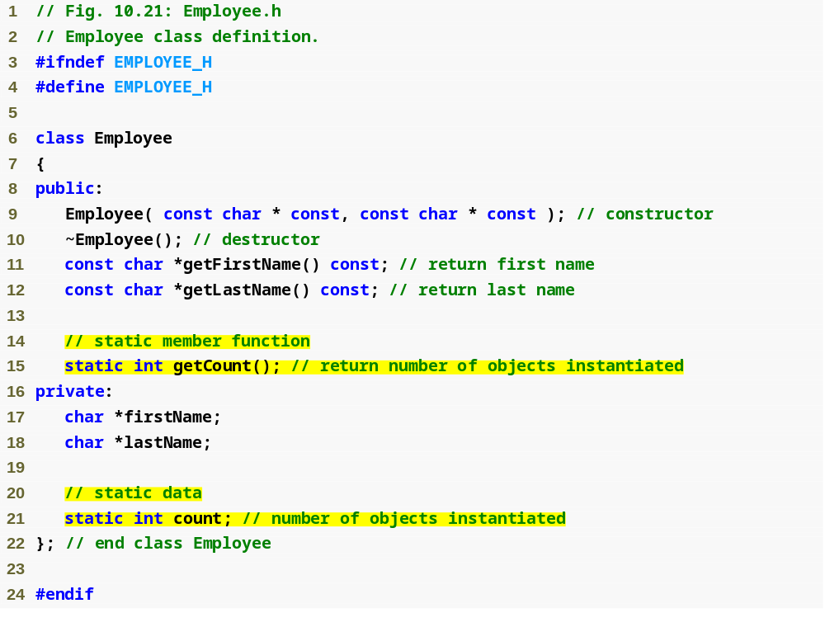
static Members – Example 14
Function prototype for static member function
static data member keeps track of number of Employee objects that currently exist

Slide 61
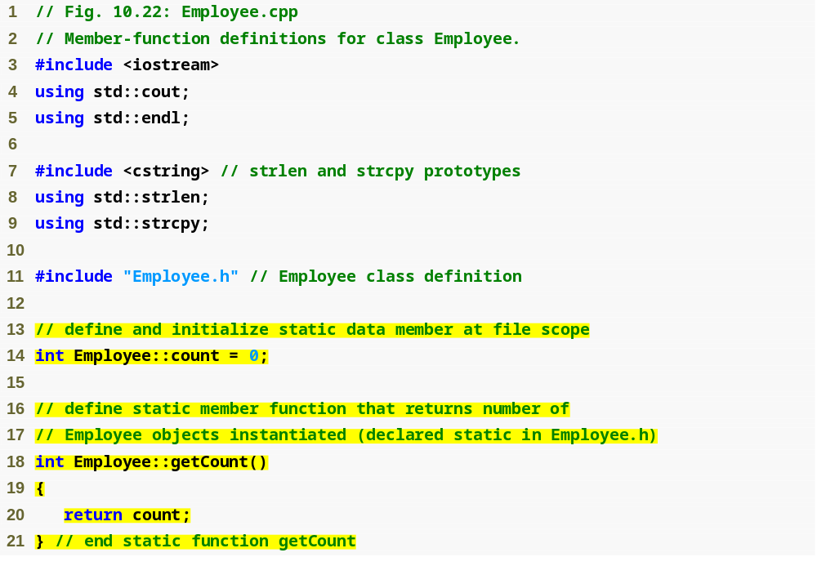
static Members – Example 14
static data member is defined and initialized at file scope in the .cpp file
static member function can access only static data, because the function might be called when no objects exist

Slide 62
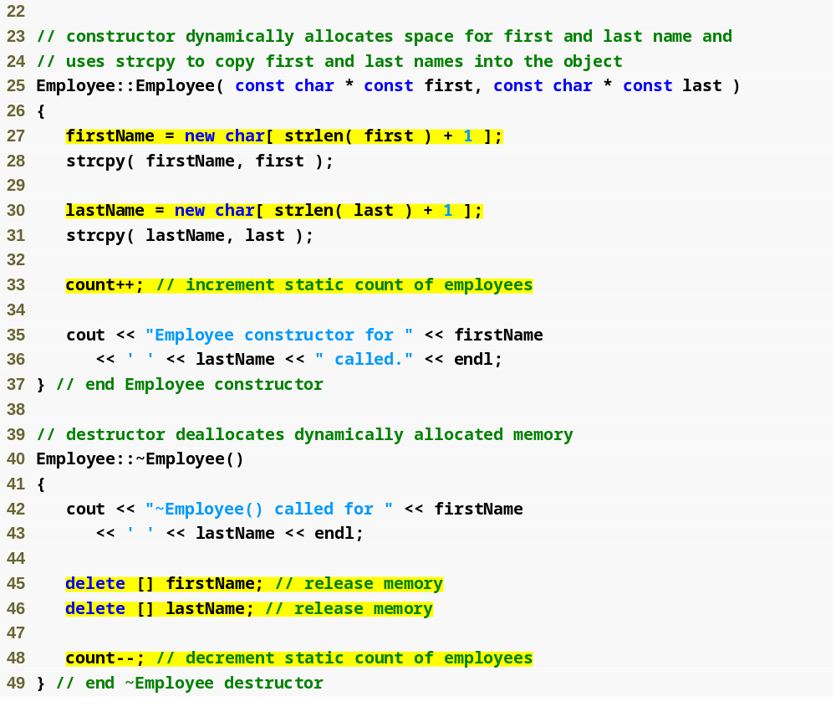
static Members – Example 14
Dynamically allocating char arrays
Non-static member function (i.e., constructor) can modify the class’s static data members
Deallocating memory reserved for arrays

Slide 63
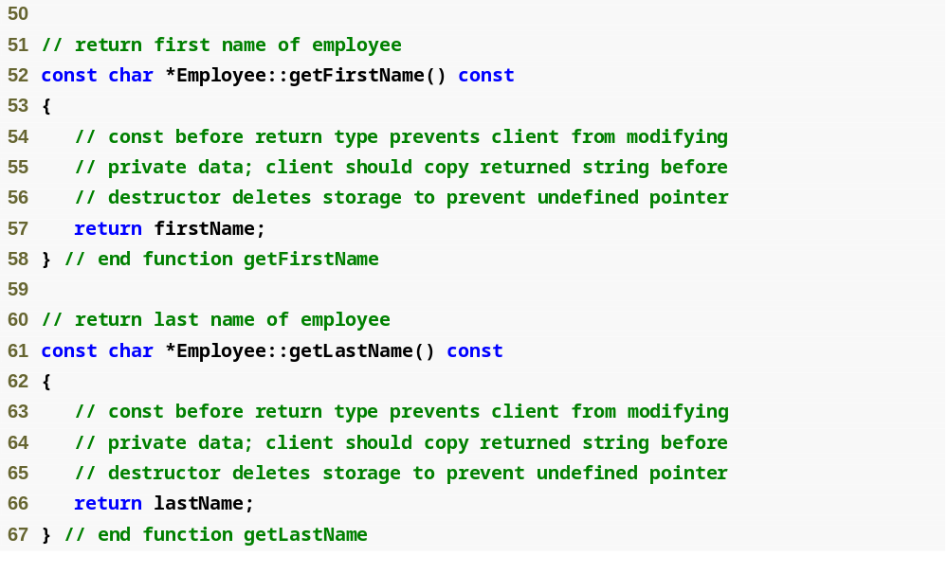
static Members – Example 14

Slide 64
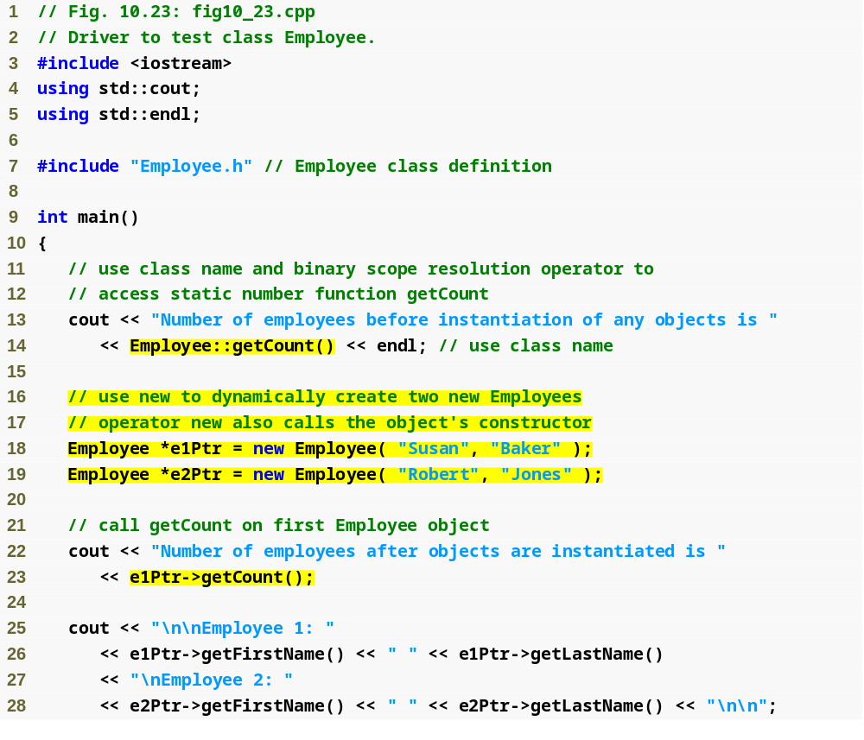
static Members – Example 14
Calling static member function using class name and binary scope resolution operator
Dynamically creating Employees with new
Calling a static member function through a pointer to an object of the class

Slide 65
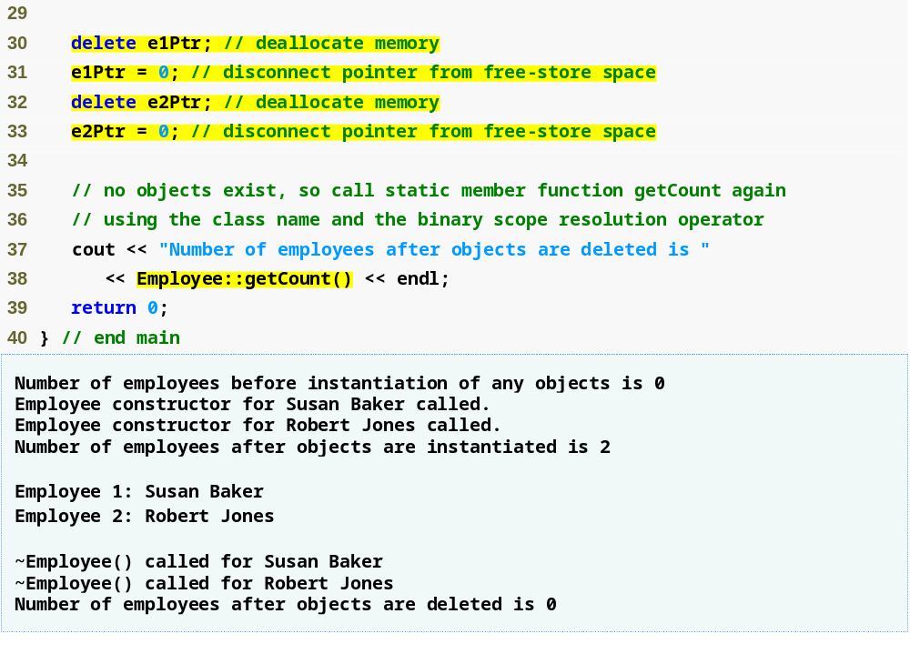
static Members – Example 14
Releasing memory to which a pointer points
Disconnecting a pointer from any space in memory

Slide 66
static Class Members
When to declare a member function static
  If it does not access non-static data members or non-static member functions of the class
A static member function does not have a this pointer
static data members and static member functions exist independently of any objects of a class
When a static member function is called, there might not be any objects of its class in memory

Slide 67
Common Programming Error 10.12
Declaring a static member function const is a compilation error. The const qualifier indicates that a function cannot modify the contents of the object in which it operates, but static member functions exist and operate independently of any objects of the class.

Slide 68
Error-Prevention Tip 10.2
After deleting dynamically allocated memory, set the pointer that referred to that memory to 0.
  This disconnects the pointer from the previously allocated space on the free store.
  This space in memory could still contain information, despite having been deleted.
  By setting the pointer to 0, the program loses any access to that free-store space, which, in fact, could have already been reallocated for a different purpose.
  If you didn't set the pointer to 0, your code could inadvertently access this new information, causing extremely subtle, nonrepeatable logic errors.

Slide 69
Data Abstraction & Information Hiding
Information Hiding
  A class normally hides implementation details from clients
Data abstraction
  Client cares about what functionality a class offers, not about how that functionality is implemented
    For example, a client of a stack class need not be concerned with the stack’s implementation (e.g., a linked list or an array)
  Programmers should not write code that depends on a class’s implementation details
    A client should be able to use a stack abstract data type without needing to know or worrying if it's implemented using an array or a linked list
    Technically the way an abstract data type is implemented should be able to be changed without the client needing to know about it or worry about anything

Slide 70
Data Abstraction & Information Hiding
Importance of data
  Elevated in C++ and object-oriented community
    Primary activities of object-oriented programming in C++
      Creation of types (i.e., classes)
      Expression of the interactions among objects of those types
  Abstract data types (ADTs)
    Improve the program development process
Abstract data types (ADTs)
  Essentially ways of representing real-world notions to some satisfactory level of precision within a computer system
  Types like int, double, char and others are all ADTs
    e.g., int is an abstract representation of an integer
  Capture two notions:
    Data representation
    Operations that can be performed on the data
  C++ classes implement ADTs and their services

Slide 71
Could Create an Array ADT
Many array operations not built into C++
  e.g., subscript range checking
Programmers can develop an array ADT as a class that is preferable to “raw” arrays
  Can provide many helpful new capabilities
  With C++ classes you can develop this new preferable array data type
These new data types and be proprietary or placed in standard class libraries for wide distribution
C++ Standard Library class template vector
  We'll go over vector in more detail later in the semester

Slide 72
Software Engineering Observation 10.12
You can create new types through the class mechanism.
  These new types can be designed to be used as conveniently as the built-in types.
  Thus, C++ is an extensible language.
  Although the language is easy to extend with these new types, the base language itself cannot be changed.

